Slide 1
Icon Library Technology Items

Slide 2

Computer

Slide 3

Gaming Console

Slide 4

Laptop

Slide 5

Mobile Phone

Slide 6
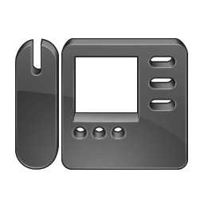
Phone

Slide 7

Printer

Slide 8


Security

Slide 9

Smart Fridge

Slide 10
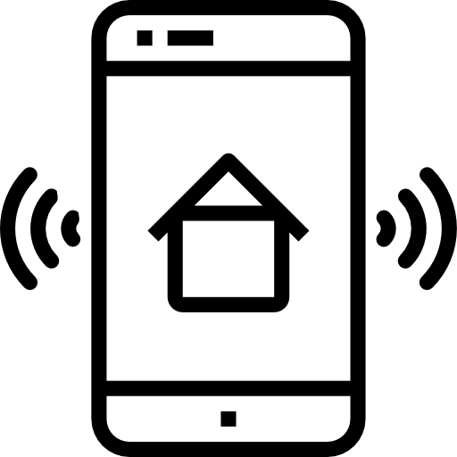
Smart Home Device

Slide 11
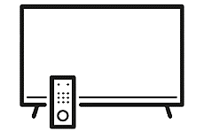
Smart TV

Slide 12

Tablet

Slide 13

TV Stream

